Slide 1
Assembly
presentation
1
Notes:
Ask pupils about the story of Jack and the Beanstalk. Ask a pupil to retell the story or outline the key points of Jack swapping the family cow for some miraculous beans that grew a giant beanstalk.

Slide 2

Notes:
You may remember that, in the story, Jack is on his way to market to sell the cow because his family needed food to eat. We have all just been through a very strange few months with being in lockdown and perhaps there were times when you were unable to buy the food you needed.

Slide 3
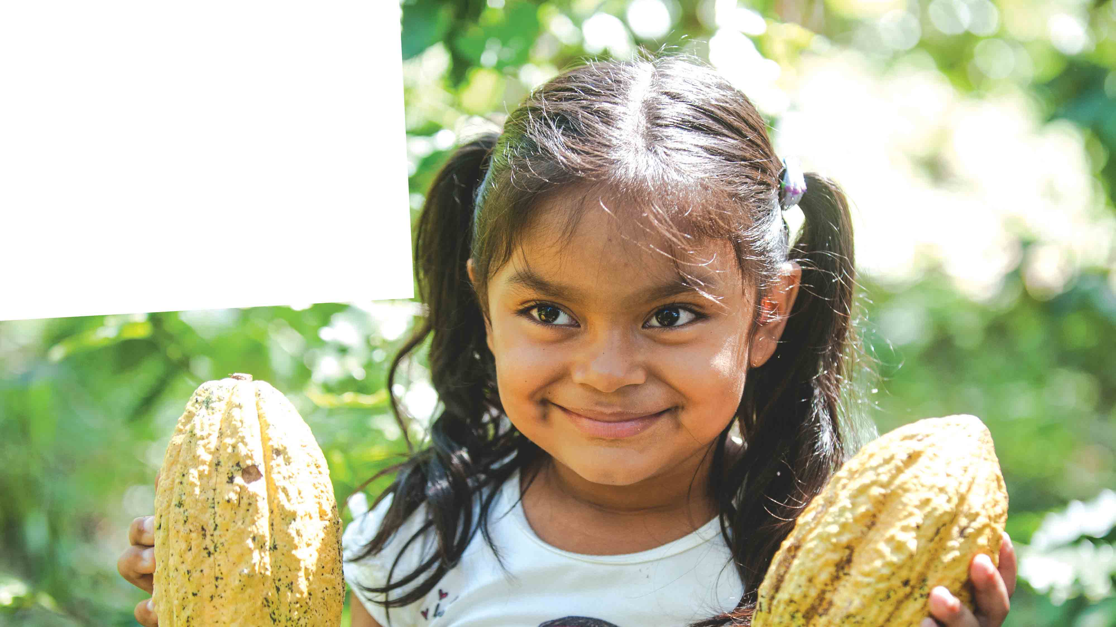

Ariana and the
Wonder Beans
3
Notes:
Explain that Jack and the Beanstalk is, of course, a made-up story, but that today you want to tell the children the true story of Ariana and the Wonder Beans.

Slide 4
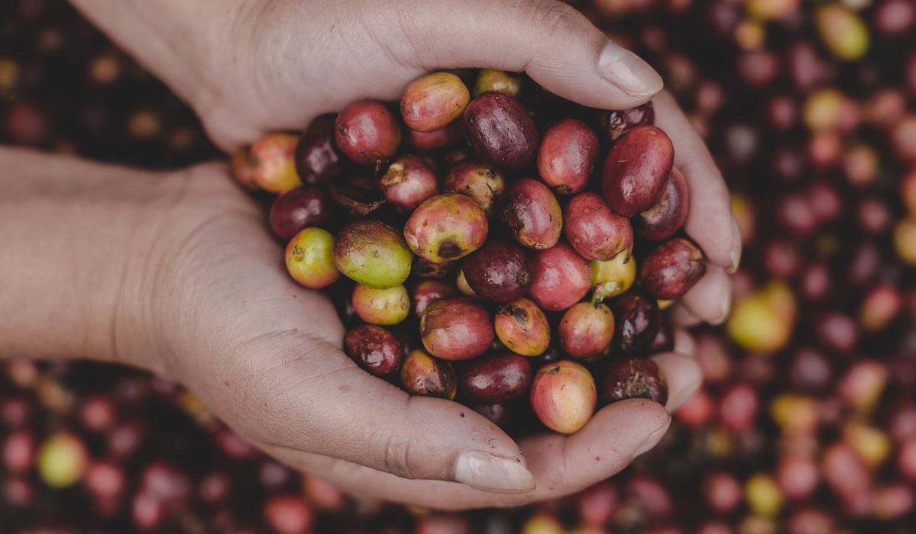

Notes:
Unlike Jack’s story, which began with selling a cow to get some beans, Ariana’s story starts by having beans already – coffee beans!
Ask the children if they like coffee or if they know someone who does.

Slide 5
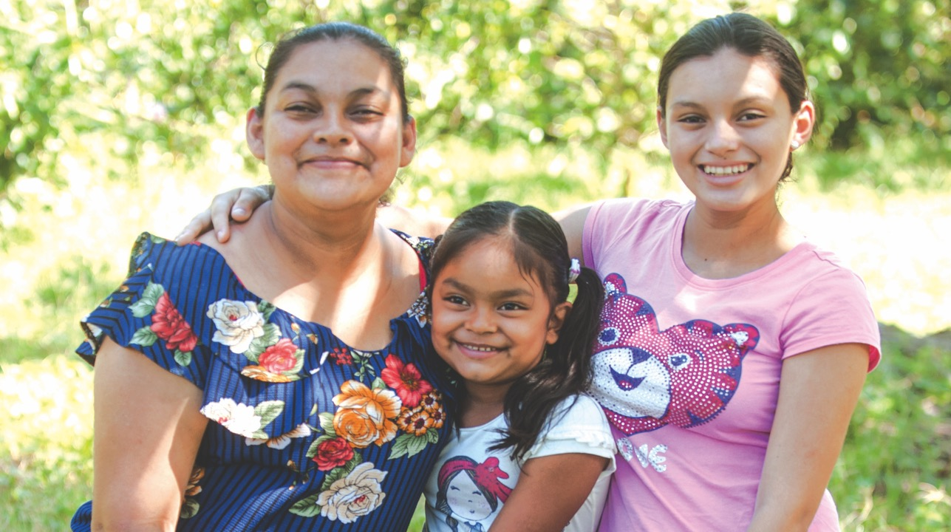
Notes:
This is Arianna. She is five years old and lives with her mum, Angela, and her 15-year-old sister Johaira.

Slide 6
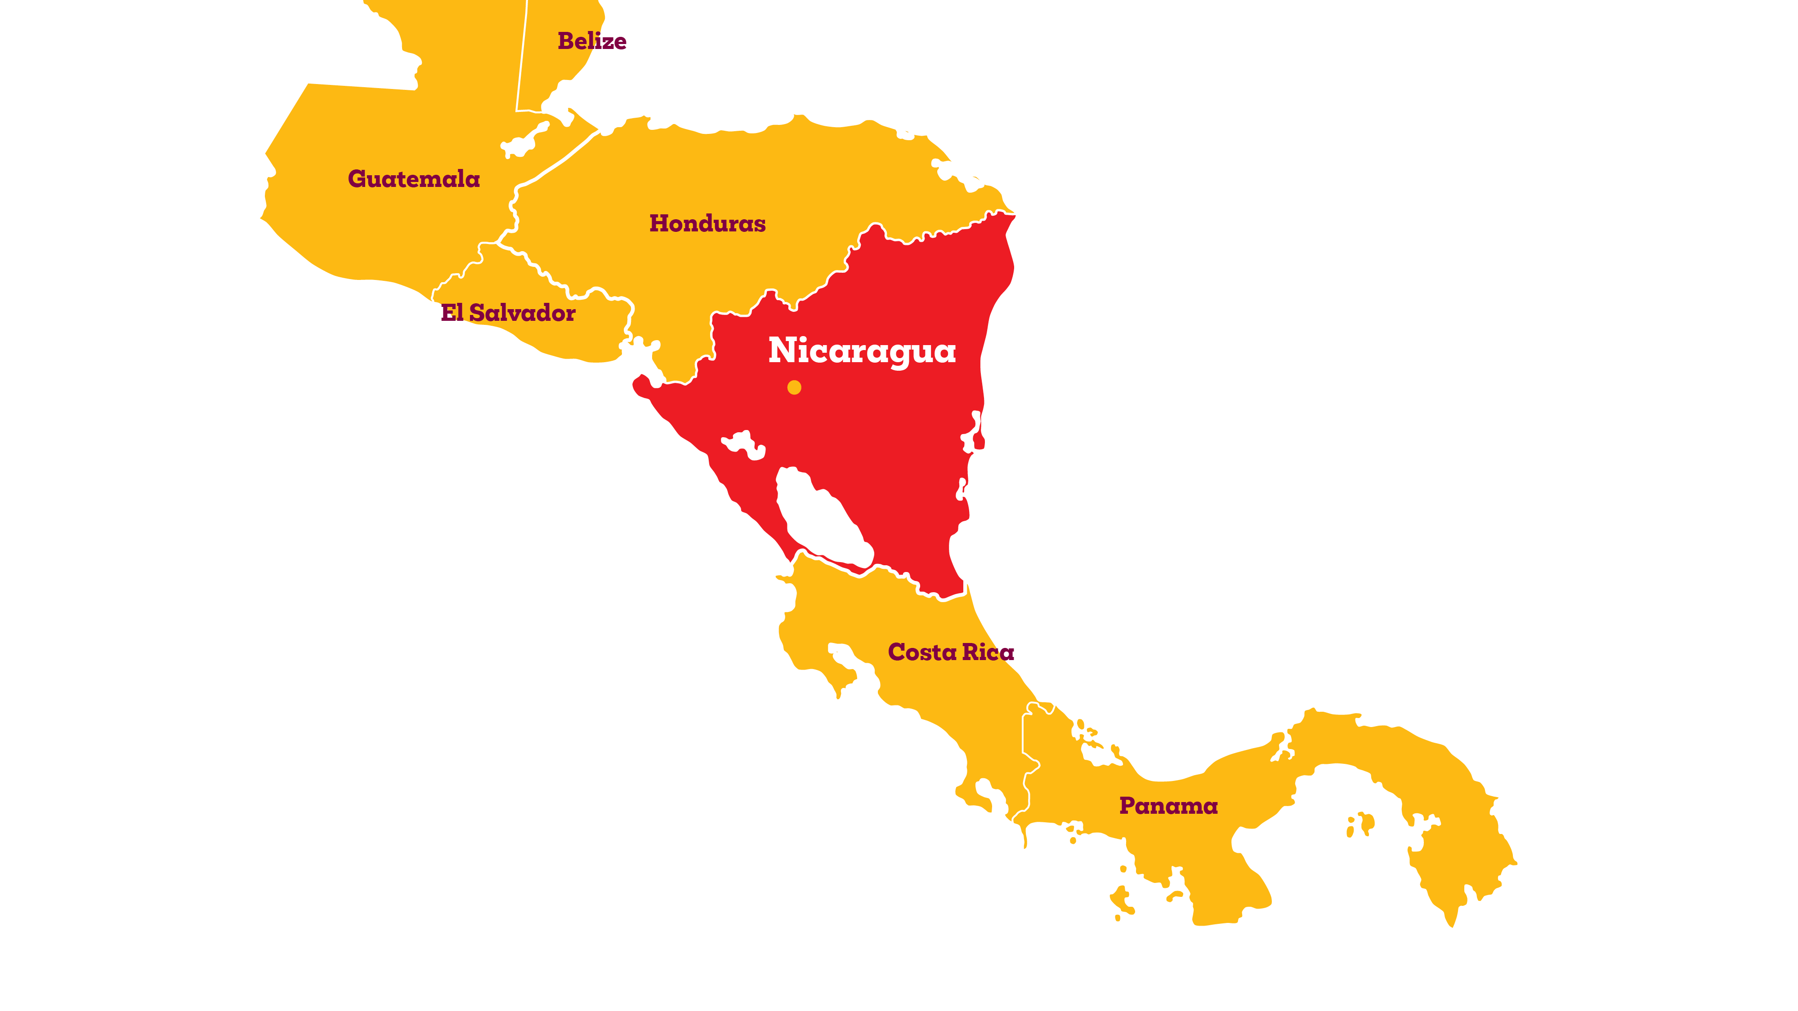

Notes:
They live in a village called Santa Rosa, in Nicaragua in South America.

Slide 7
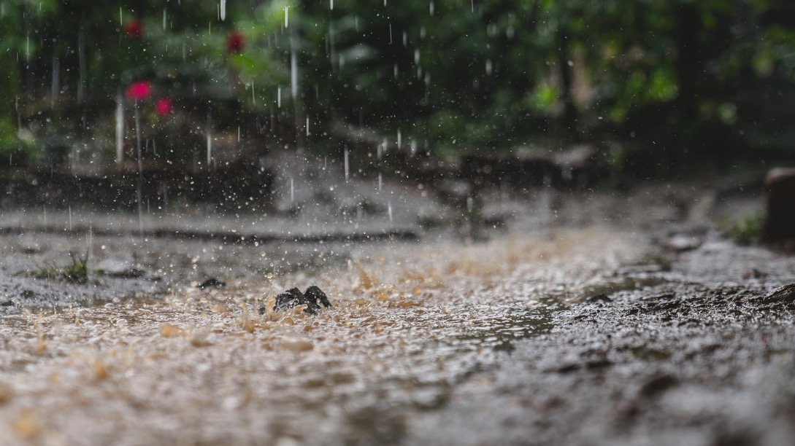
Notes:
Angela used to make a living by growing coffee beans, which provided a good income for the family. However, in recent years, the weather in Nicaragua has been unpredictable because of climate change and this has made it harder to grow coffee.

Slide 8
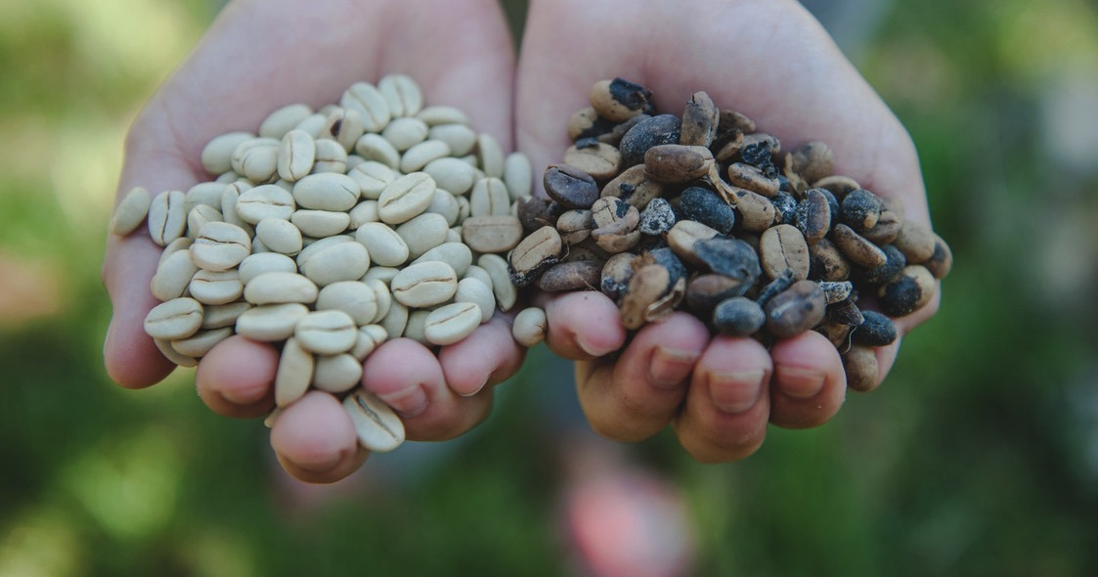
Notes:
Angela explained: ‘With climate change, the coffee suffers from many diseases and pests. The sun has scorched the coffee beans, we cannot sell them and we’re losing more every year because of climate change. When I was a kid, the weather was totally different. It’s been changing a lot and we don’t know when it’s the rainy season or the dry season. There’s been days with rain, then days with lots of sun.’

Slide 9
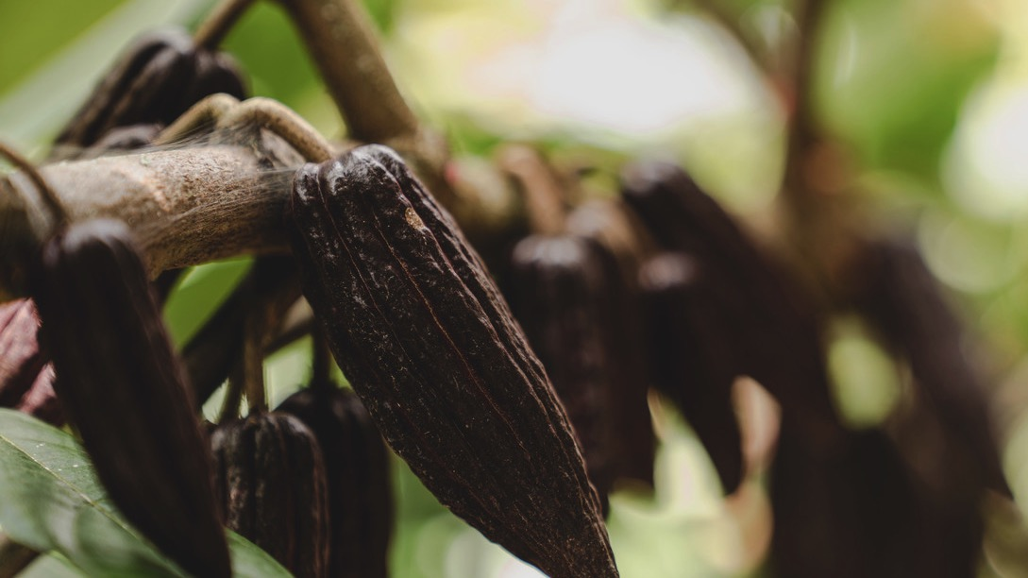
Notes:
To solve the problem, Angela and her neighbours who are also farmers, have joined together to help each other out and, with the support of an organisation called Soppexcca and the charity Christian Aid, have swapped their coffee beans for cocoa beans. Changing the crops that you normally grow is called diversification.

Slide 10

Notes:
The wonder cocoa beans are amazing, not only because they can grow in changing weather conditions but because they are also used to produce chocolate! The beans also have lots of other uses. As the pupils if they like chocolate.

Slide 11
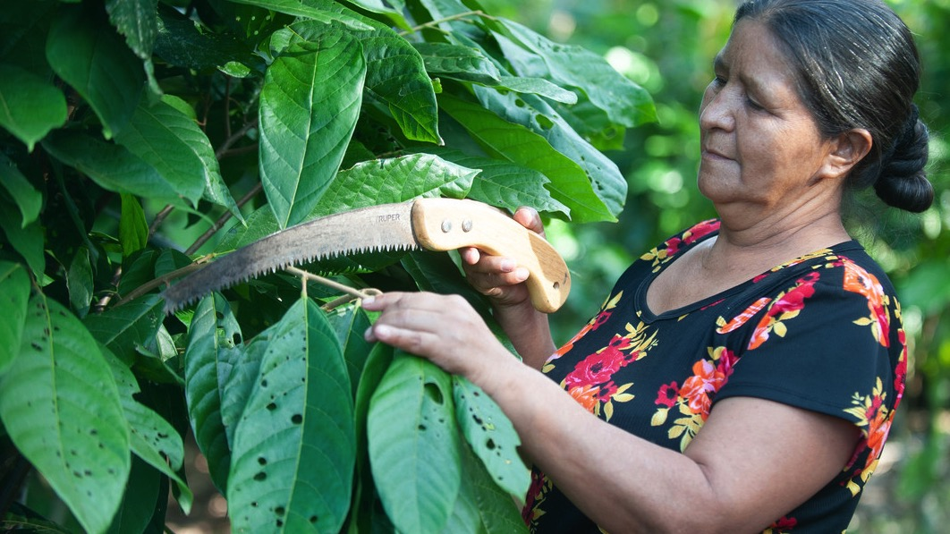
Notes:
The neighbours help each other out. They look after the crops together and share tools and knowledge. This means they can grow a bigger crop and then, at harvest time, they can get a better price for their beans, which enables them to buy food, medicine and clothes.

Slide 12
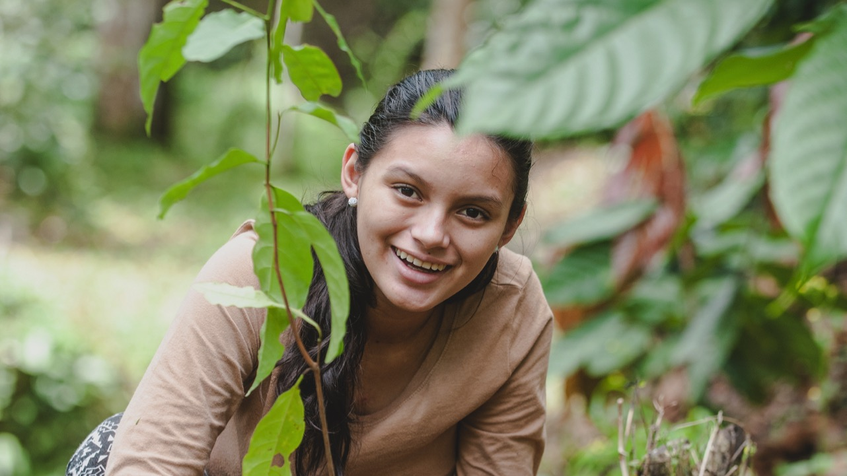
Notes:
Everyone in the community has a part to play in helping the beans grow. Young people, like Ariana’s sister Johaira, are trained as youth promoters who visit the farmers to record their progress and share know-how. It’s helped build trust between the generations.
Johaira said: ‘Sometimes I feel nervous about telling farmers what they need to do, but as a promoter I feel good and am always learning more. I am fascinated now by the farm and the crops. When I was little, I knew nothing, but you can see the difference with my little sister. She’s only five and knows how to collect the coffee beans!’

Slide 13
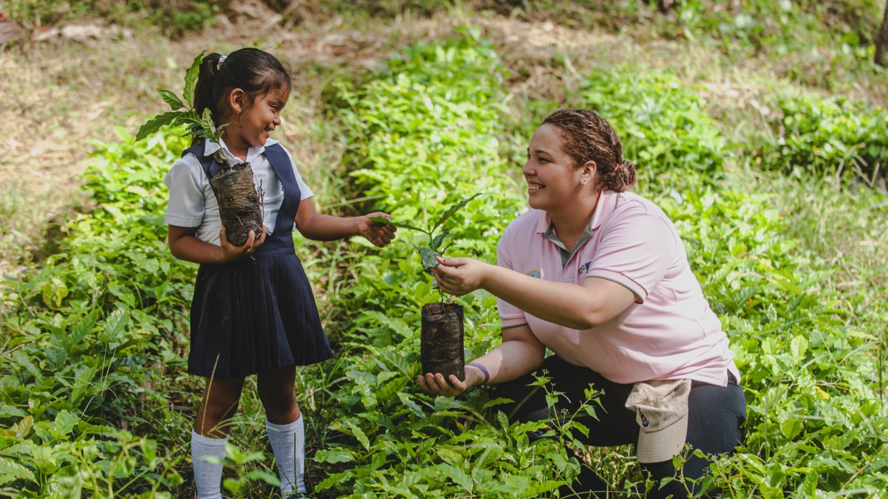
Notes:
Ariana really wants to be a farmer when she grows up: ‘When I grow up, I would also like to grow cocoa. I really like cocoa!’
Can you think of a time recently when you worked together with your community, either in school or at home, to help your neighbours? Ask the pupils to share their thoughts.

Slide 14
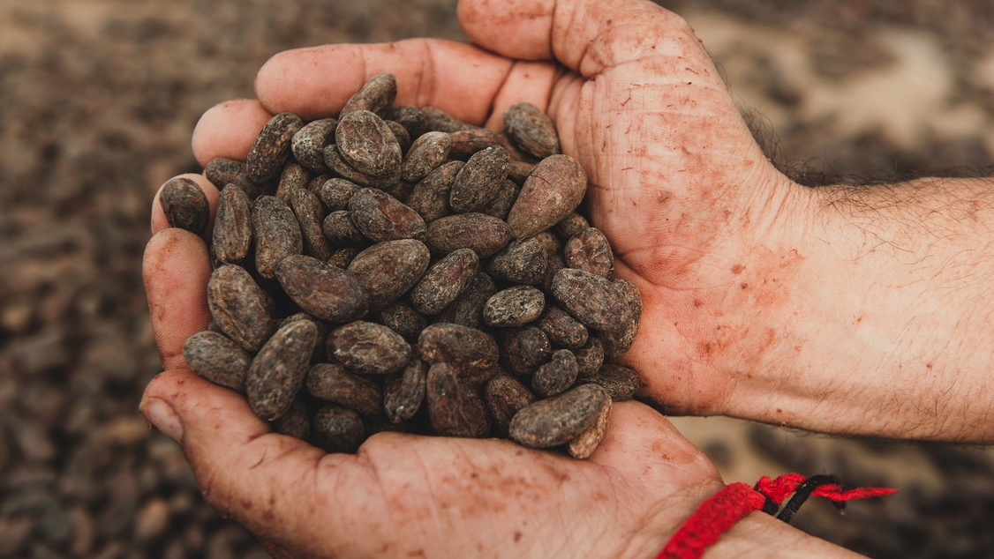
Notes:
When ordinary neighbourhoods come together, they can create lasting change. Just like during coronavirus lockdown and just like in Santa Rosa. In times of crisis, love unites us all.

Slide 15

Love knows no distance.
Notes:
Around the world, many of our global neighbours living in poverty continue to face difficulties. Love knows no distance. We can all reach out to our global neighbours and help more communities overcome hard times. End your presentation by telling pupils about any further work or fundraising activities you will be doing to support Christian Aid’s Autumn Appeal.

Slide 16
Christian Aid is a key member of ACT Alliance. Eng and Wales charity no. 1105851 Scot charity no. SC039150 Company no. 5171525 Christian Aid Ireland: NI charity no. NIC101631 Company no. NI059154 and ROI charity no. 20014162 Company no. 426928. The Christian Aid name and logo are trademarks of Christian Aid. © Christian Aid July 2020 Photos: Christian Aid J192551
16

