Slide 1
About Christian Aid South Sudan and the Country Programme
J. Wani
Country Director – South Sudan

Slide 2
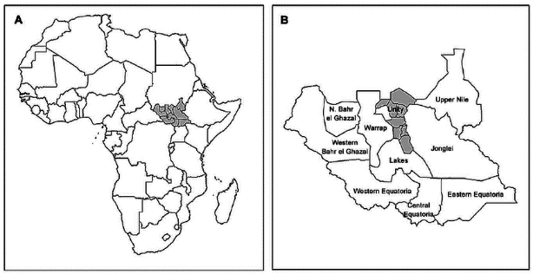
About Christian Aid SS
Christian Aid has been working in the Sudan and present day South Sudan since the 1970s.

Slide 3
South Sudan Country Background
It is about the size of France/2.5 times bigger than UK
Population of about 8 million at the time of independence in 2011

Slide 4
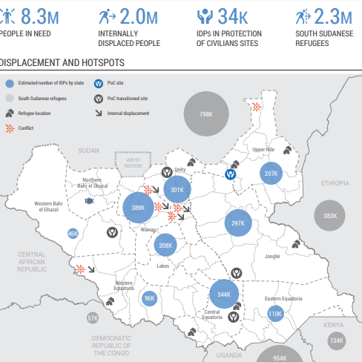
South Sudan Country Context

Slide 5
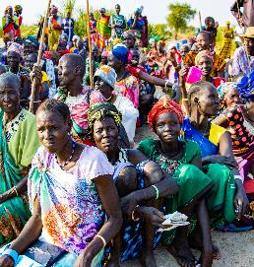
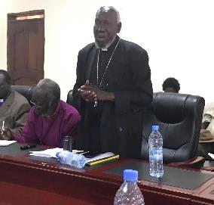
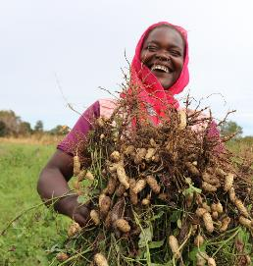
SS Country thematic Priorities
From Violence to Peace
Advocacy
Peace building
Reconciliation
Psychosocial Support and Trauma Healing
Conflict Transformation
Climate Resilience & Nutrition
Food security
Technological advancement
Climate resilience through community-led engagement.
Nutrition advocacy
Tackling malnutrition among pregnant and lactating mothers, and children under 5.
Humanitarian programme
Lifesaving Interventions
Support for recovery of livelihoods and services
Water, Sanitation and Hygiene
Emergency shelter for the most vulnerable
Community-led DRR measures and early warning system for resilience
Conflict sensitivity
Gender and Social Inclusion (GESI)

Slide 6
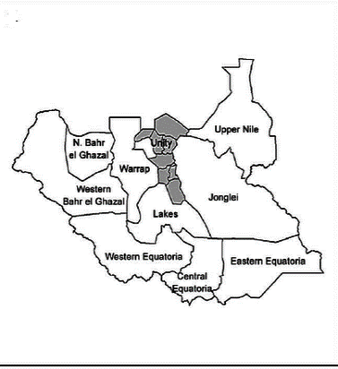
CA response to crisis in Mayendit
Grant Source: Scottish HEF
Project location: Mayendit
Type of shock: climate related/floods – compounded by COVID-19 & conflict
Impact of the hazards:
Floods related displacement: 15,000 to 24,000 people according to Interagency Assessment carried out in August 2021
Conflict related displacement: 310,000
Needs of the affected population
Food
Non-food, particularly shelter, Mosquito nets
Emergency WASH kit
COVID-19 risk mitigation measures
Protection
Project Outcome 1: Cash transfers to 1637 households (8185 people)
Outcome 2: 1700 households (8750) supported with seeds & tools. A further 1050 households (5250) given basic fishing kit (hooks and twine).
Outcome 3: 22,185 to be reached with information on Covid-19 prevention through house to house visits in markets and at food distribution sites

Slide 7
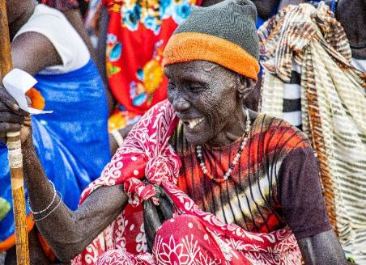
Case Story from cash response
Nyakuoth 82-year-old was displaced by flood.
She was among those selected by CA partner UNIDOR to benefit from cash assistance through Scottish government grant because she is vulnerable as an elderly woman at brink of hunger

Slide 8
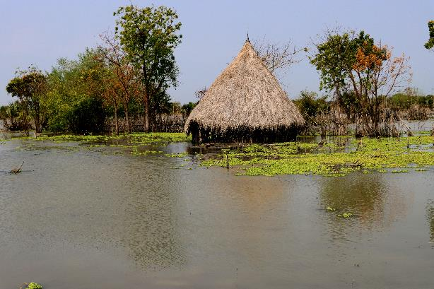
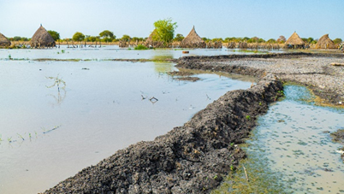
Impact of the floods in Nyakuoth Village in Theker
Her homestead in Theker Village still sits in Water
The dikes made by the community to safeguard against flooding were overwhelmed
In addition to cash, households in this village have been selected to receive farming tools, vegetable seeds & fishing kit to support them recovery
Subject to availability of future funds, CA and partner will carryout PVCA to enable the community better prepare and mitigate future floods

Slide 9
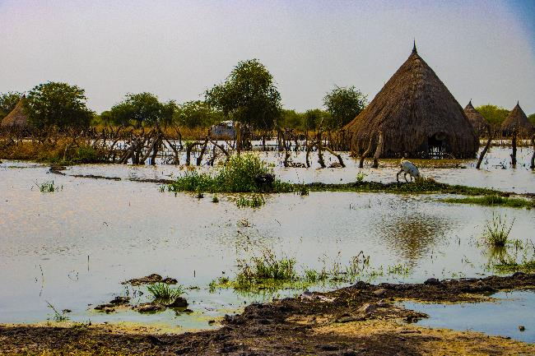
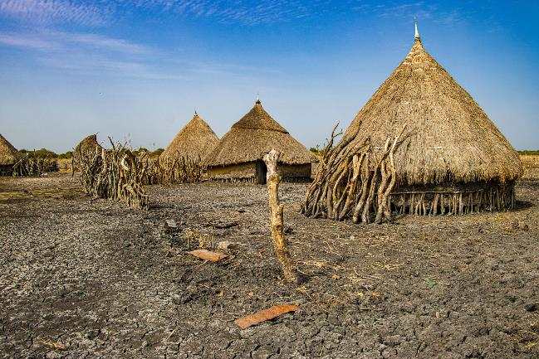
Support to recovery
Water level receding in some parts of the village as captured most recent during field visit
In addition to cash, 1,700 vulnerable households most impacted in villages such as the one shown have been selected to receive farming tools & vegetable seeds to support resumption of basic livelihoods
Subject to availability of future funds, CA and partner will carryout PVCA to enable the community better prepare and mitigate future floods

Slide 10
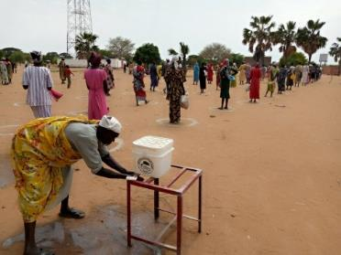
COVID-19 awareness
Presents real danger
22,000 reached with critical messages on preventive measures

Slide 11
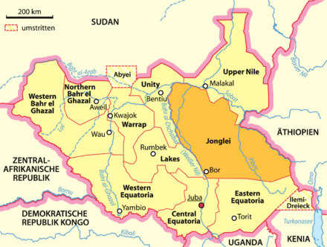
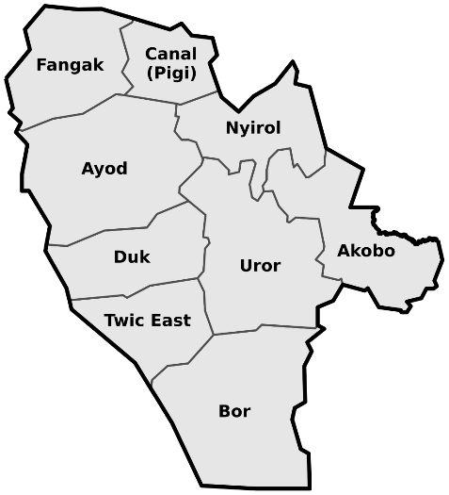
DEC and Hunger appeal
Partner: Africa Development Agency (ADA)
Donor(s): DEC, ACT Alliance, Hunger appeal
Sectors: Cash & WASH, Livelihoods, protection, Shelter, DRR
Drivers of humanitarian vulnerability: Unprecedented level of floods, Compounded by conflict & COVID-19
Intervention: Unconditional cash, plastic sheets, COVID-19 and hygiene awareness, PPE and training; Seeds, tools and fishing kits, community led DRR action planning using PVCA approach

Slide 12
Challenges
Donor fatigue
High operational costs
Bureaucratic impediments/increased interference
Personal safety and security risks - South Sudan ranks among the works in terms of risks to Aid workers

Slide 13
Opportunities
CA’s legacy and identity as a faith-based humanitarian and development actor
CASS reach and operational capacity
CA approach - localization
In-country funding opportunities - UN pool funds, FCDO,EU/ECHO
ACT Alliance

Slide 14

Q&A

