Slide 1
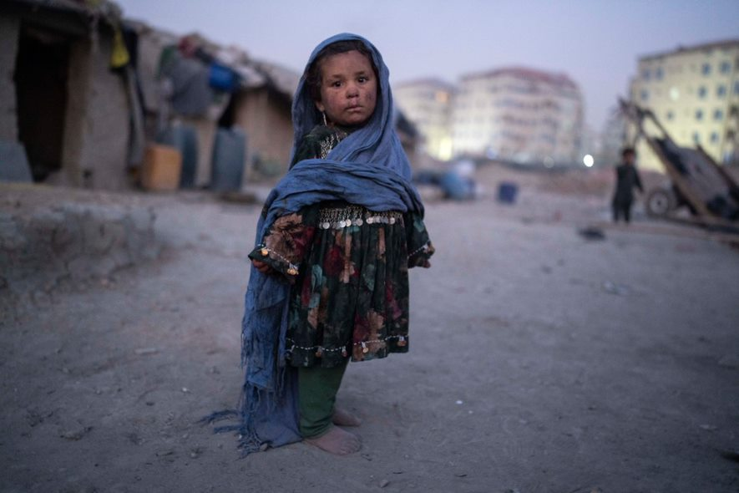
Afghanistan Emergency Appeal
This child lives in a internally displaced people’s neighbourhood in Kabul. Children are particularly at risk of hunger. Photo credit: Petros Giannakouris/AP/Shutterstock

Slide 2
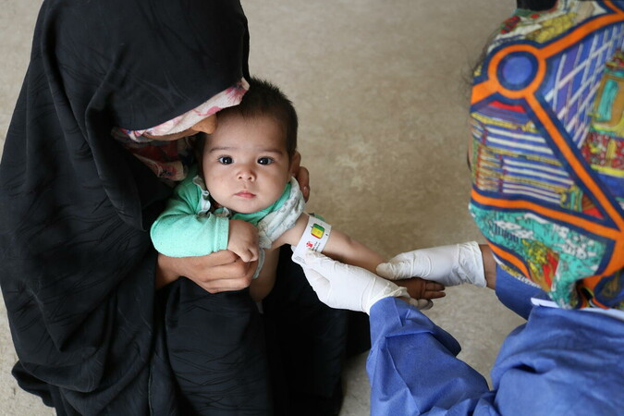
Afghanistan Crisis
22 million women, men, and children facing hunger this winter
Combination of drought, conflict and Covid-19 causing dramatic rise in hunger
A health worker checks children for malnutrition.
Photo credit: Save the Children

Slide 3
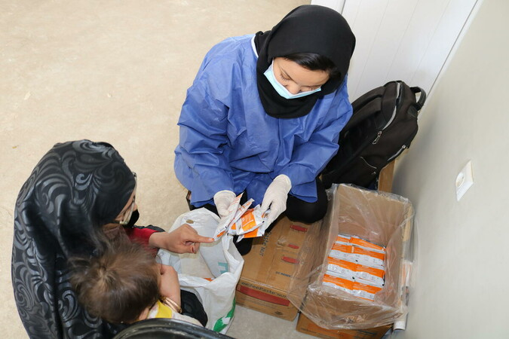
Most urgent needs
Emergency rations and cash for food
Special nutrition packs for children and pregnant mothers
Shelter from the bitter winter weather
Nutrition supplements are provided for young children and pregnant mothers.
Photo credit: Save the Children

Slide 4
We are responding
Christian Aid is acting as part of the Disasters Emergency Committee to raise urgent funds
Our local partners are already supporting the most vulnerable
In the coming weeks our partners will distribute food, nutrition packs, and winter shelter
You can donate at caid.org.uk/winter-crisis

Slide 5
Prayer for Afghanistan
Come, Jesus…
Come, our Saviour,
come to all the people in Afghanistan,
in this bleakest of winters.
Come, with food and water,
to feed the hungry and refresh the thirsty ones.

Slide 6
Prayer for Afghanistan
Come, once a child yourself,
come to the children and the babies,
when so many cry with hunger pangs
and parents would give everything to feed them.

Slide 7
Prayer for Afghanistan
Come, the peace bearer,
come and bring your shalom to this land
after forty years of brutal war.
Come to those displaced and uprooted,
to a people fearful and vulnerable to violence.

Slide 8
Prayer for Afghanistan
Come, the light in our night,
come to families cold and shivering,
when infection passes from one to another,
while the economy is broken,
and creation groans in pain.

Slide 9
Prayer for Afghanistan
For all people, of all faiths,
to all children of every family,
in all the places where mothers weep and children cry,
come, God made vulnerable flesh,
to touch your world with true hope once more.

Slide 10
Prayer for Afghanistan
Turn our sorrow at the suffering of children,
and our determination that hate will not win,
into something we can do.
Take the money we give and the prayers we pray,
and stir in us, and in all your people,
whatever is needed for a new world to come.

Slide 11
Prayer for Afghanistan
From the depths of a bitter winter,
may hope spring.
Amen.
Written by Revd Dr Susan Durber
Moderator, Faith and Order Commission, WCC

Slide 12
Please donate today caid.org.uk/winter-crisis

